Slide 1
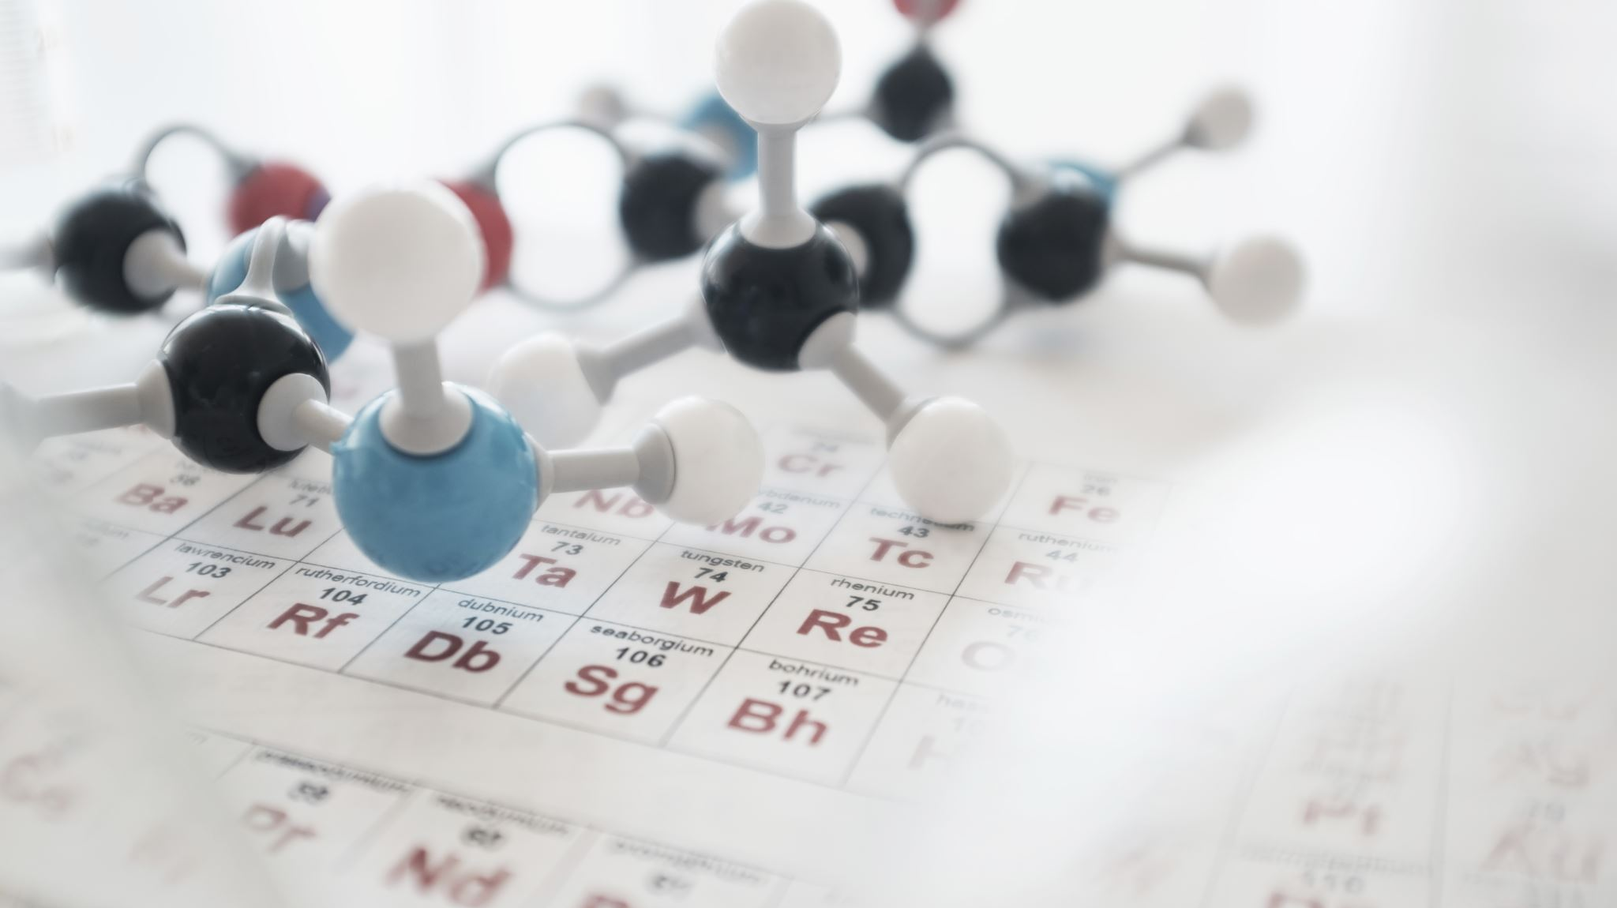
2.2 Trends in Groups within the Periodic Table
•• Learn about the similarities between different elements in the same groups in the Periodic Table
• Relate the structure of the Periodic Table to the structure of the elements
• Use the Periodic table to predict the structure and properties of elements
• Make careful observations.

Slide 2
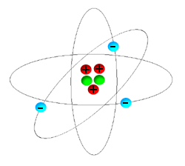
What holds the electrons in its energy level?
There is an attraction between the positive and negative charges.
This electrostatic attraction between the positive charge on the protons and the negative charge on the electrons is what holds individual atoms together.

Slide 3
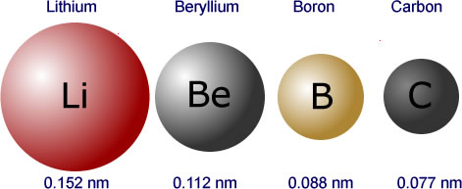
Compare the size of elements as we go down in the same group and same period
Same group
Same period

Slide 4
Trends of atomic size within the periodic table
The atoms of the elements increase in mass as you progress from left to right (starting with hydrogen) and downwards in the Periodic Table.
Decrease in mass as we move from left to right across the same period

Slide 6
Quick fact
The metal loses electrons to form + ion.
Non-metal gains electrons to form – ion.
Electrostatic attraction force between + and – ions.

Slide 7
Activity Time

Slide 9
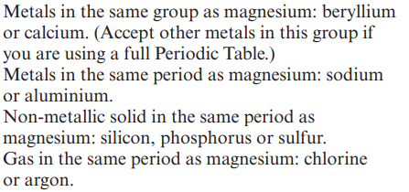

Slide 10
Names of groups at periodic table

Slide 11
Group 1: The alkali metals
The first group, also known as the alkali metals, includes the elements lithium, sodium and potassium. The elements have some properties in common. The table below contains data about three of the elements in Group 1.

Slide 13
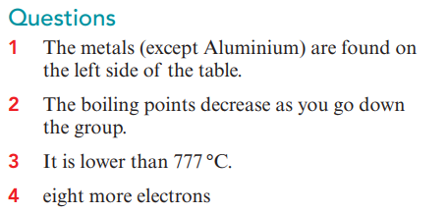

Slide 14
What happens as we move from up to down across the same group?
The number of protons increases, The mass number increases.
What is similar about their structure?
They have the same number of electrons (one) in the outer shell and have 1 in the inner shell and both have 2 in the inner shell.
What is different about the three atoms?
The atoms get larger / there are more electron shells as you go down the group. The atoms have a larger mass / more protons and neutrons as you go down the group.

Slide 15
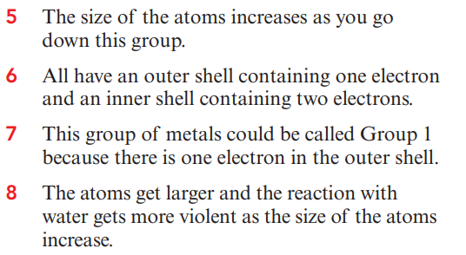

Slide 16
The Halogens

Slide 17
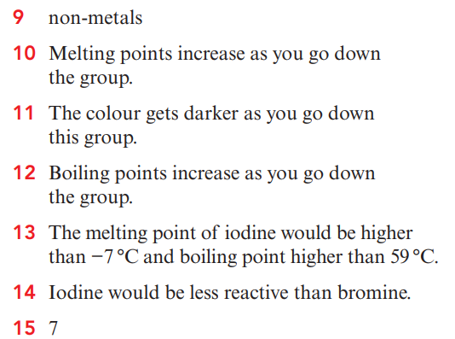

Slide 18
Compare between the 2 elements

Slide 19
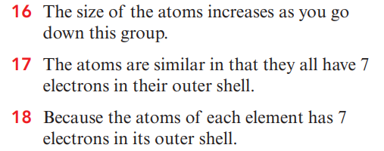

Slide 21
Compare between the following elements

Slide 22
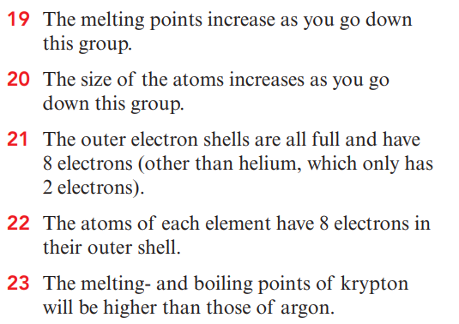

Slide 23
Plenary

