Slide 1
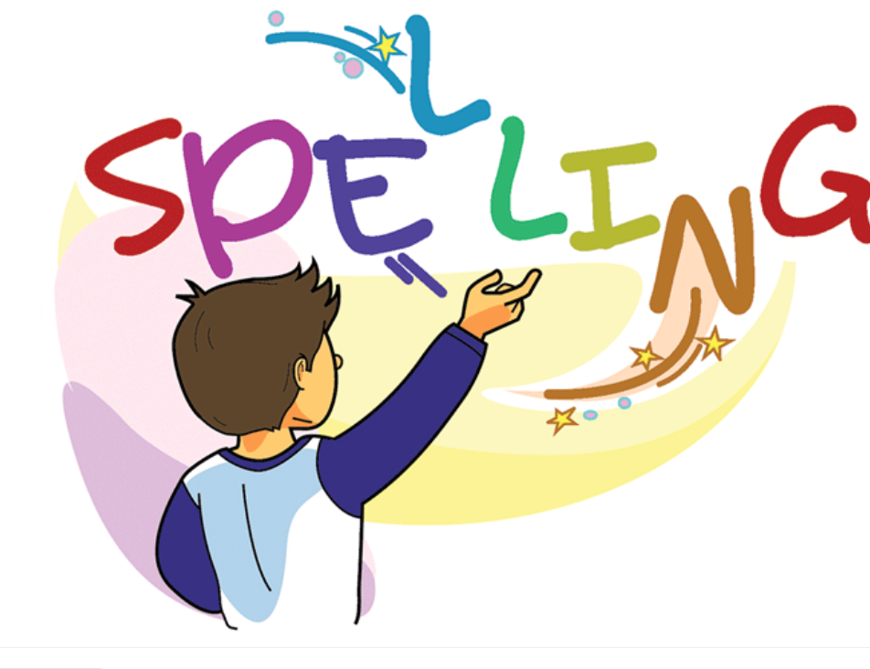

Slide 2
Spelling Test words with /ear/ words with /are/ sound. (15 mins)

Slide 3
Words with the /ear/ sound
Scavenger Hunt Game in the playground.
On index cards or small papers write the following words
Beard, ear, tear, spear, gear, near, fear, hear, rear,
dear, year
Explain to the students the scavenger hunt game.

Slide 4
1.Place the words around the playground.
On the slides,
In the jungle gym house,
On the swing, under the picnic
Tables.
Give each student his/her clip board and paper and pencil.
As students to look for the words with the /ear/ sound and write the words down.
Allocated time 10 min.

Slide 5
Spelling Words Words with /ear/ sound
beard
A man's beard is the hair that grows on his chin and cheeks.
Grandpa has a long white beard on his face.

Slide 6
ear
Your ears are the two parts of your body, one on each side of your head, with which you hear sounds.
I have two small ears.

Slide 7
tear
Tears are the drops of salty liquid that come out of your eyes when you are crying.
Her eyes filled with tears.

Slide 8
near
If something is near a place, thing, or person, it is a short distance from them.
He sat near the fire to get warm.

Slide 9
hear
When you hear a sound, you become aware of it through your ears.
Jessy can hear the trumpet over their house.

Slide 10
rear
The rear of something such as a building or vehicle is the back part of it.
He settled back in the rear of the taxi.

Slide 11
dear
Dear is written at the beginning of a letter or email, followed by the name or title of the person you are writing to.
Dear Peter, I have been thinking about you so much during the past few days.

Slide 12
fear
If you fear someone or something, you are frightened because you think that they will harm you.
I fear the lion because he is wild.

Slide 13
Thank You

