Slide 2
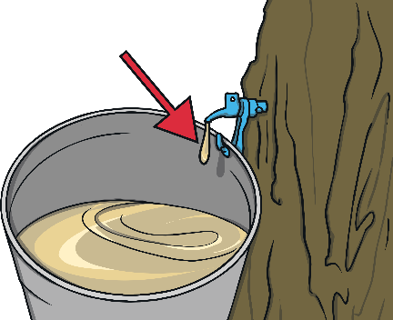
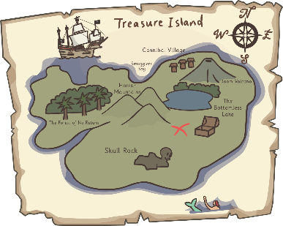
I Can Read!
Can you match the word to the correct picture? Click to reveal the answer.
map
pat
sap
sat
tap

Slide 3
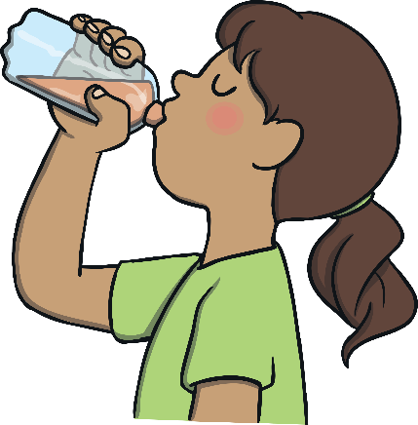
I Can Read!
Can you match the word to the correct picture? Click to reveal the answer.
pip
tip
sit
sip
pan

Slide 4
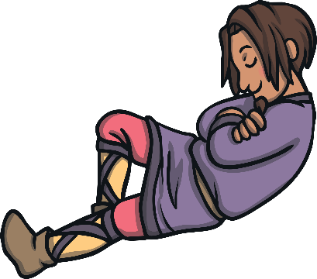
I Can Read!
Can you match the word to the correct picture? Click to reveal the answer.
tin
tan
pin
nap
man

Slide 5
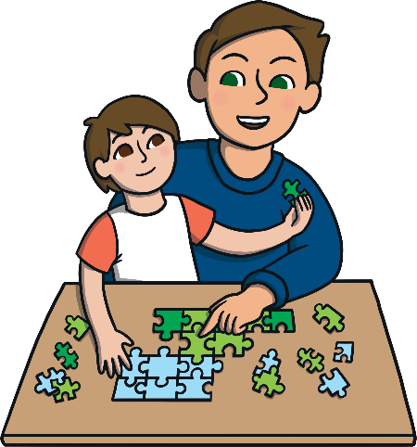
I Can Read!
Can you match the word to the correct picture? Click to reveal the answer.
mat
dad
pit
dip
sad

Slide 6
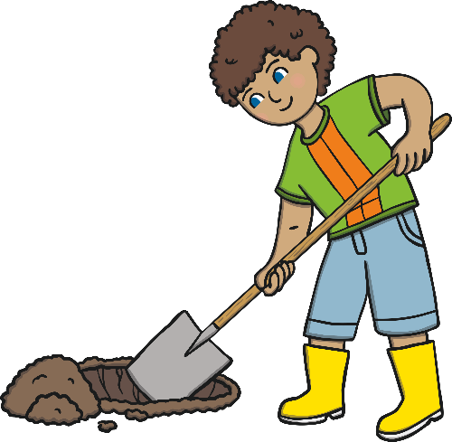
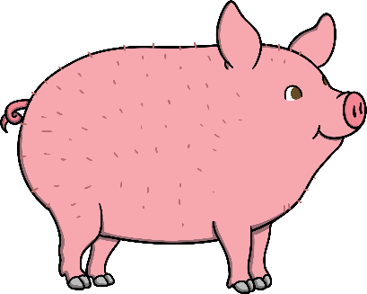
I Can Read!
Can you match the word to the correct picture? Click to reveal the answer.
tag
pot
gap
dig
pig

Slide 7
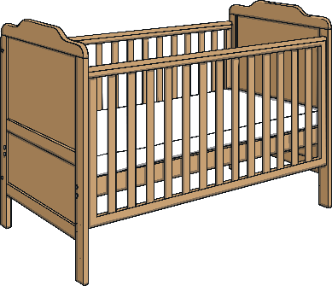
I Can Read!
Can you match the word to the correct picture? Click to reveal the answer.
top
dog
log
can
cot

Slide 8
I Can Read!
Can you match the word to the correct picture? Click to reveal the answer.
cop
cap
cat
cod
kid

Slide 9
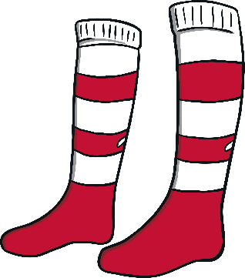
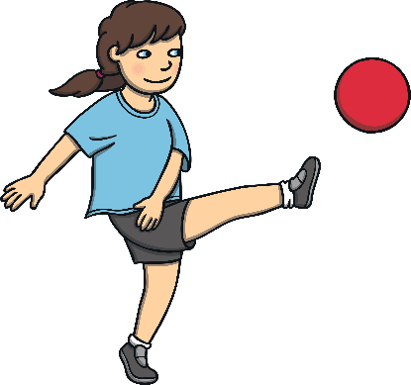
I Can Read!
Can you match the word to the correct picture? Click to reveal the answer.
kick
sock
sack
pick
pack

