Slide 2
Aim
To learn what alliteration is.
Success Criteria
We will understand what alliteration is.
We will be able to recognise alliteration in a text.
We will be able to make some of our own examples of alliteration.

Slide 3
What is Alliteration?
Alliteration is the repetition of the same sound or letter at the beginning of each or most of the words in a sentence.
Aside from tongue twisters, alliteration is also used in poetry to create different effects, either for a description or to create more drama or danger.
Alliteration is often used in song lyrics, and within store or brand names.

Slide 4
Examples of Alliteration
In these cartoon characters’ names there is alliteration:
Mickey Mouse
Minnie Mouse
Donald Duck
Photo courtesy of Loren Javier (@flickr.com) - granted under creative commons licence - attribution

Slide 5
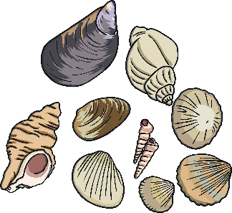
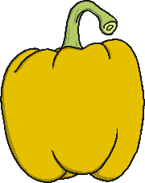
Examples of Alliteration
In these tongue twisters you can see alliteration:
She sells seashells down by the seashore.
Peter Piper picked a peck of pickled peppers.
They are both alliterative phrases. In the first one, all the words start with the ‘s’ sound, while in the latter, the letter ‘p’ is first in each word.

Slide 6
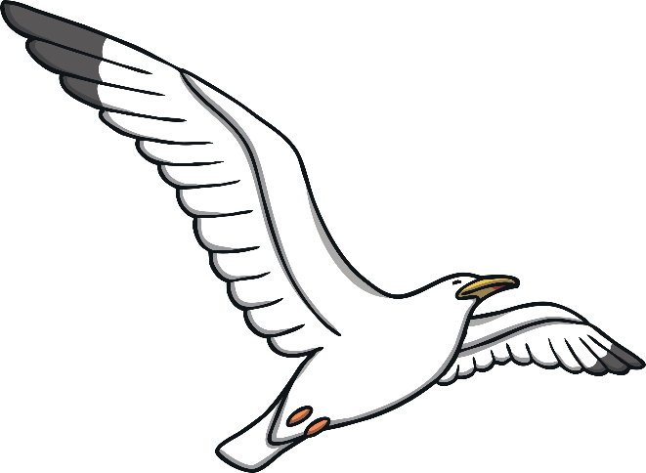
Examples of Alliteration
Here are some more examples of alliteration using a letter:
Squawking seagulls swoop on sunbathers.

Slide 7
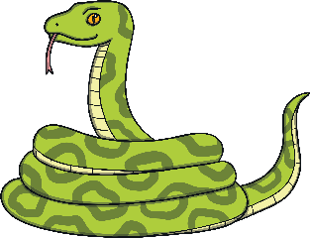
Examples of Alliteration
Sam sees six slimy, smooth, slithering snakes.

Slide 8
Examples of Alliteration
Ten terrible tigers tore Tony’s teddy!

Slide 9
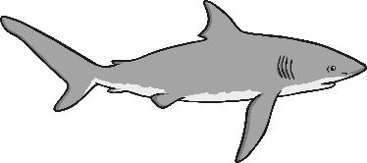
Examples of Alliteration
Seven snapping sharks swim in the sea.

Slide 10
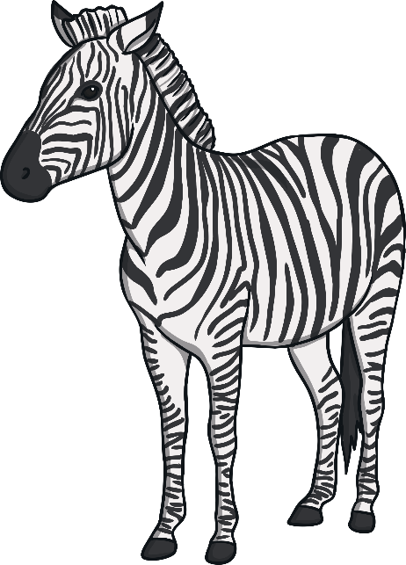
Examples of Alliteration
Zany zebras zigzagged through the zoo.

Slide 11
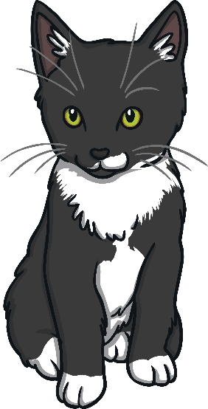
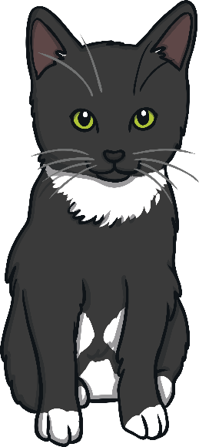
Examples of Alliteration
Carrie cuddled the cute, curious cats.

Slide 12
Your turn!
Can you think of your own sentences using alliteration?

