Slide 1
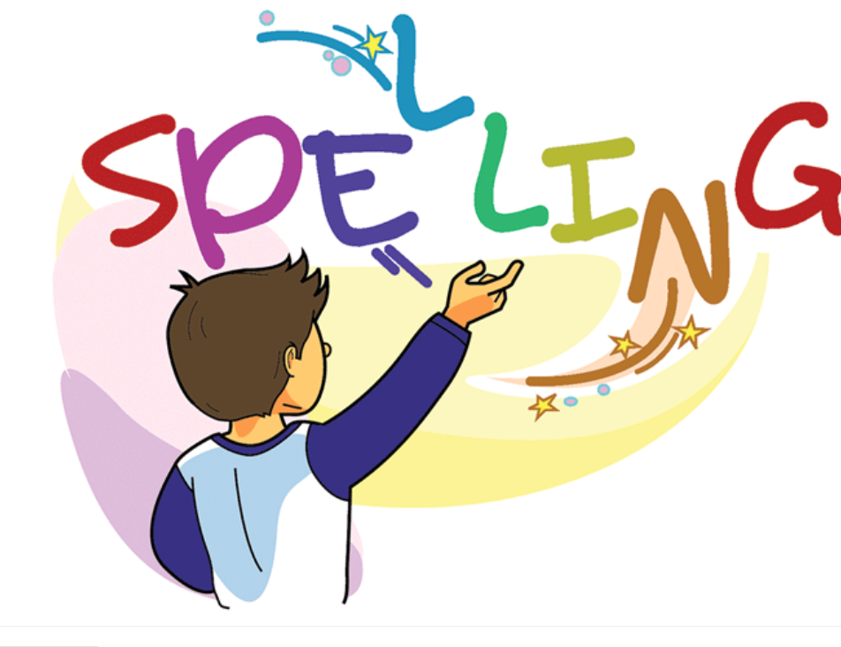

Slide 2
ea with the short sound /e/
The short vowel sound ea does not follow the rule and makes the short /e/ sound.
“When two vowels go walking the first one does the talking.”
ea is often found in the middle of the word and it is followed
by the following letters:
-d-------- head sure------ measure
-t -------- sweat th-------- feather
However there are words that still don’t follow this rule.

Slide 3
Sorting ea words into long sound /ee/ and short sound /e/
Mix up several ea cards with the long vowel sound /ee/ ex. peach and
the short sound letter /e/ ex. head.
Have students sort the long and short vowel ea patterns in the correct
categories

Slide 4
ea short sound /e/
bread | head | thread | spread
sweat | feather | weather | health
wealth | breath
ea long sound /ee/
team | dream | leaf | beach
cream | sea | tea | teach
seal | eat

Slide 5
Vowel Pattern ea Sorting Mat
ea (Peach) | ea (head)

Slide 6
Spelling Words ea with the short sound /e/
head
Your head is the top part of your body, which has your eyes, mouth, and brain in it.
I bumped my head on the door

Slide 7
bread
Bread is a very common food made from flour, water, and yeast.
Get the bread so we can make a sandwich

Slide 8
thread
Thread is a long very thin piece of a material such as cotton, nylon, or silk, especially one that is used in sewing.
I will sew the buttons with a needle and thread.

Slide 9
spread
If you spread a substance, you put a thin layer of the substance over the surface.
Spread the bread with jam.

Slide 10
sweat
Sweat is the salty colourless liquid which comes through your skin
when you are hot, ill, or afraid.
They are sweating as the sun beat down upon them

Slide 11
feathers
A bird's feathers are the soft covering on its body.
Birds grow their full feathers in the weeks after leaving the nest.

Slide 12
Weather
The weather is the condition of the atmosphere in one area at a particular time, for example if it is raining, hot, or windy.
I like cold weather.

Slide 13
health
Health is a state in which a person is not suffering from any illness and is feeling well.
My health is good because I eat fruits and vegetables.

Slide 14
Wealth
Wealth is having of a large amount of money, property, or other valuable things.
They have great wealth.

Slide 15
breath
Your breath is the air that you let out through your mouth when you breathe.
He took a deep breath, and began to climb the stairs.

Slide 16
Thank You

