Slide 1
Spelling 2
Year 4 – Term 2

Slide 2
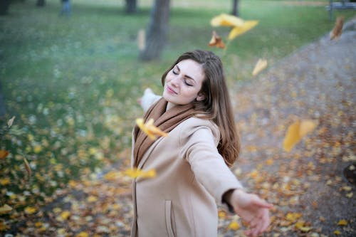
Pleasure (n.): A happy feeling you get from doing something you enjoy. Antonym: displeasure (n.) Synonym: happiness (n.)
Examples:
Example 1: I felt pure pleasure finishing my first storybook all by myself.
Example 2: Playing with my puppy fills me with so much pleasure!

Slide 3
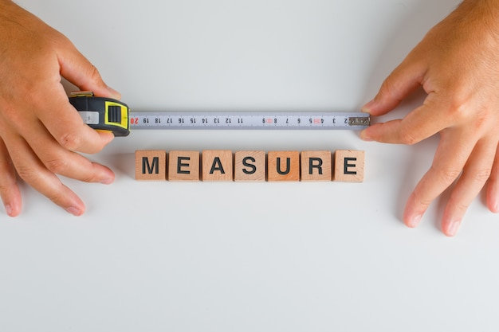
Measure (n.): How much something is. Synonym: size, amount, quantity, extent Antonym: smallness, littleness, insignificance
Example 1: We used a cup to measure the flour for the cake.
Example 2: Can you measure how tall I am against the doorframe?

Slide 4
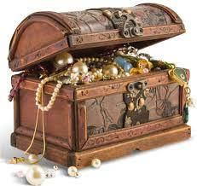
Treasure (n.): Something very valuable and precious that you keep safe.
Example 1: Grandma's old locket is a treasure passed down through generations.
Example 2: I treasure the memories we made at the beach last summer.

Slide 5
Enclosure (n.): A closed space surrounded by something. Antonym: openness, freedom, space, Synonym: cage, pen, box, container,
Example 1: The penguins live in a special enclosure at the zoo.
Example 2: My blanket became my cozy enclosure on a rainy day.

Slide 6
Closure (n.): An ending to something, often bringing a feeling of completeness Synonym: ending, completion, resolution Antonym: uncertainty, suspense, doubt, incompleteness
Example 1: The book ending gave me closure by explaining the mystery.
Example 2: Saying goodbye to friends can be hard, but it brings closure to our visit.

Slide 7
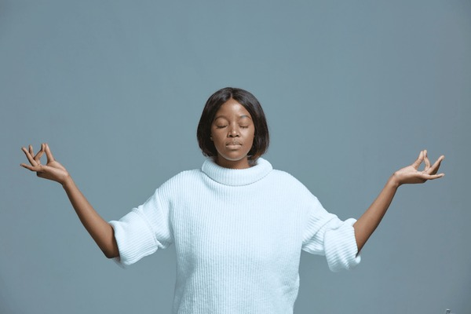
Composure (n.): Staying calm and collected, even in a difficult situation. Synonym: calmness, coolness, serenity Antonym: nervousness, anxiety, stress
Examples
Example 1: The firefighter showed great composure while rescuing the kitten from the tree.
Example 2: Taking a deep breath helped me find my composure before giving my presentation.

Slide 8
Leisure (n.): Free time you have to relax and do what you enjoy. Synonym: free time, spare time, downtime, relaxation, vacation Antonym: busyness, work, occupation, engagement
Example 1: I spend my leisure time reading exciting books.
Example 2: During playtime, we have leisure to swing, climb, and draw.

Slide 9
Exposure (n.): Being outside and in the open, or letting something be seen or experienced. Synonym: experience, visibility, revelation Antonym: concealment, shelter, isolation
Example 1: The class took a nature walk to get exposure to different plants and animals.
Example 2: The artist's paintings were hung in a gallery for everyone's exposure.

Slide 10
Disclosure(n.): Telling someone something secret or hidden. Synonym: revelation, confession, announcement Antonym: concealment, secrecy, withholding
Example 1: The magician made a grand disclosure of his final trick.
Example 2: It's important to tell your friend the truth in your next disclosure.

Slide 11
Fissure (n.): A long, narrow crack in something like the ground or a rock. Synonym: crack, gap, split Antonym: smooth, whole, unbroken
Example 1: The earthquake caused a deep fissure in the road.
Example 2: The climbers carefully crossed the icy fissure in the glacier.

Slide 12
Pressure (n.): Force pushing or squeezing something, or feeling stressed or worried. Synonym: force, stress, anxiety Antonym: ease, relief, relaxation
Example 1: The balloon popped because of too much pressure from the air inside.
Example 2: I felt a lot of pressure to do well on the spelling test.

Slide 13
Pure (adj.): Completely clean with nothing else mixed in. Synonym: clean, unmixed, genuine Antonyms: dirty, polluted, fake
Example 1: Grandma's cookies are made with pure chocolate chips and melted butter.
Example 2: The scientist used pure water for his experiment.

Slide 14
Cure (n.): A treatment that makes a disease or illness go away completely. Synonyms: remedy, heal, fix
Antonyms: worsen, spread, disease
Example 1: The doctor gave the dog a medication to cure its ear infection.
Example 2: There is no known cure for the common cold, but rest and fluids help.

Slide 15
Injure (v.): To hurt or damage someone or something. Synonym: hurt, harm, damage Antonym: heal, benefit, improve
Example 1: I injured my finger when I bumped it on the table.
Example 2: Please be careful not to injure the delicate plant.

