Slide 1
Rocks
Do you know
the surface of the Earth is made of rock?

Slide 2
WHAT TO KNOW
* Different rocks are used
for different jobs.
* We use rocks to build roads,
walls, houses, and to make
other things.
* Rocks can be found in soil.
* Sometimes a rock in soil is called a stone.

Slide 3
Words to learn
Rocks
Rocks
Sandstone, Granite
Limestone, Quarry,
Diamond, Quartz,
Slate, Marble

Slide 4
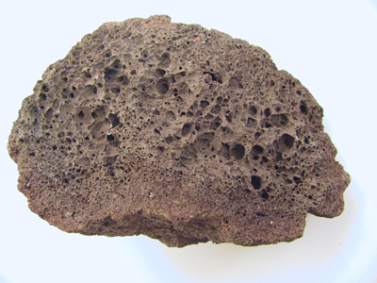
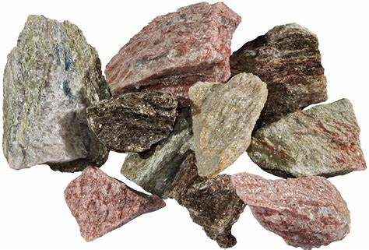
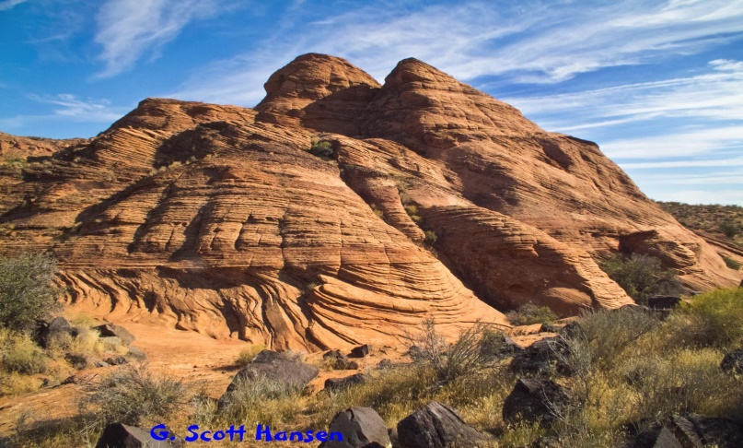
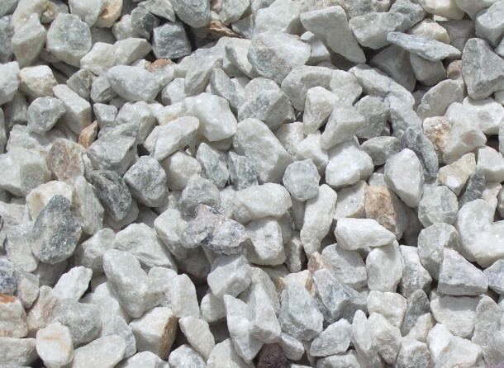
granite
sandstone
Types of Rock
limestone

Slide 5
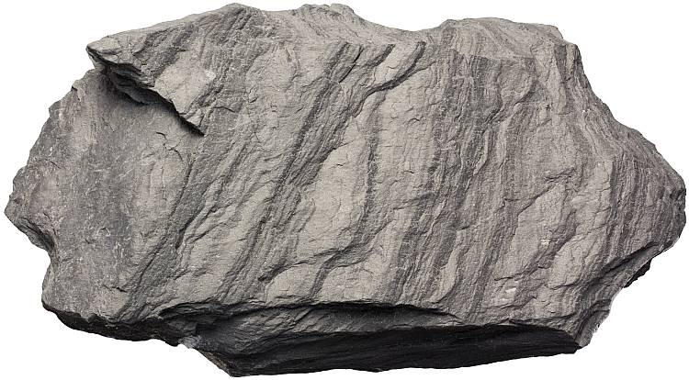
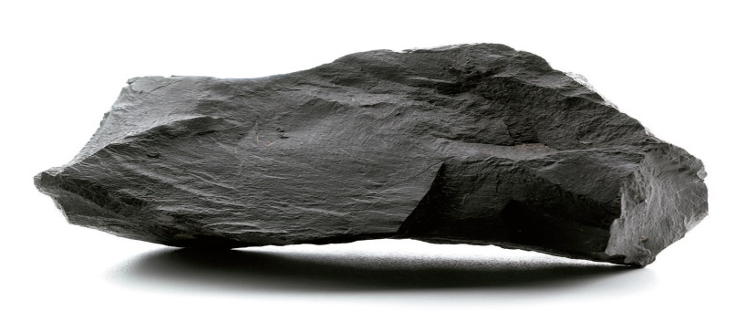
Diamond – Is very hard. It is used in jewellery and also in cutting machines.
Granite- is very strong. It is often used in building.
Slate- is hard and smooth. It is used for floor and roof tiles.
Marble- is a hard, strong and smooth rock. It is used in many types of decoration and building.

