Slide 1
9.2 Current and voltage in parallel circuits
Learning Objectives:
1-compare current and voltage in series and parallel circuits
2-describe the effects of adding cells and lamps on current and voltage in circuits

Slide 2
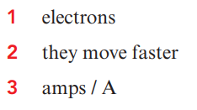
Pre-Assessment

Slide 3
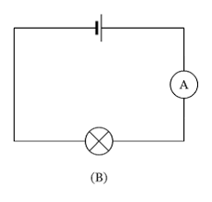
Look to the following diagram then answer the following question? How the voltmeter and Ammeter connected in a circuit?
Warming Up

Slide 4
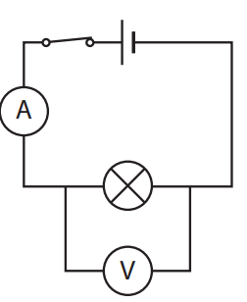
Write down the differences between ammeter and voltmeter
Ammeter | Voltmeter
Measures the current flowing through a component. | Measures the energy difference either side of a component.
Ammeter is connected in series with the component. | Voltmeter should be connected in parallel with components in a circuit.

Slide 5
Quick –Assessment

Slide 6
Let’s Check the answers and give points

Slide 7
What happens to current by adding more components in series circuit
Watch this simulation then answer the following questions?
1- What happens to current by adding more components in series circuit? Why?
2-What happens to current by adding more components in parallel circuit? Why?

Slide 8
What will happen to current by adding more components in series circuits?
Adding more components in a series circuit will decrease the current.
As components are added, it becomes more difficult for the power supply to push the electrons around the circuit.
Compare these two series circuits. The one with more components has a smaller current

Slide 9
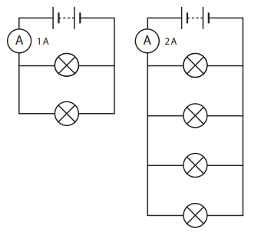
What happen to current when adding more components in a parallel circuit?
Adding more branches to a parallel circuit gives more paths for the current to flow through.
The more paths there are for current to flow through, the easier it becomes.
That means the current though the cell increases.

Slide 10
Quick Assessment

Slide 11
What happens to Voltage by adding more components ?
Watch this simulation then answer the following questions?
1- What happens to voltage by adding more components in series circuit? Why?
2-What happens to voltage by adding more components in parallel circuit? Why?

Slide 12
What happen to Voltage in a parallel circuit ?
The voltages across each of the branches of a parallel circuit are equal to the voltage of the supply.
The voltage of the battery in both circuits is 9 V.
you will see that the voltage across the branches of a parallel circuit is the same whether or not the components are the same.
The lamp and the buzzer are different, but the voltage across the branches is still the same (9 V).
The voltage in all branches of a parallel circuit is the same.

Slide 13
What happens to current and voltage by adding more cells?

Slide 15
What will happen to voltage by adding more components in series circuit ?
The voltage from the supply in a series circuit is shared between each of the components.
That means adding components such as lamps or buzzers will cause each component to get a smaller share of the voltage.
Compare these two series circuits.
Both have the same type of battery and both have identical lamps.

Slide 16
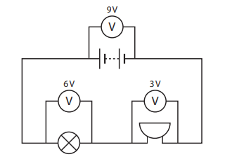
Compare between the following diagrams

Slide 17
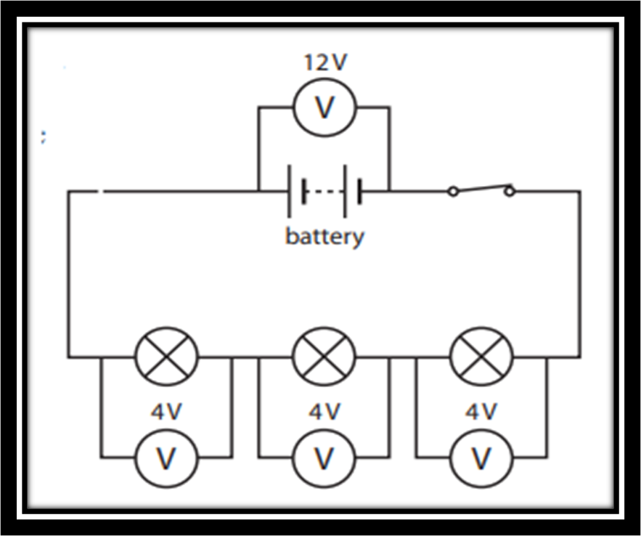
When all the components are identical | When the components are different
All three lamps are identical. | the lamp is changing more energy than the buzzer, so the voltage across the lamp is higher than the buzzer.
They change the same quantity of energy, so have the same voltage. | The voltages across the lamp and buzzer add up to the voltage of the battery.
The voltage across all the lamps adds up to the voltage from the battery. | The voltages across all the components in a series circuit add up to the voltage of the supply.

Slide 18
 | Current | Voltage
Series | Same | Shared
Parallel | Shared | Same

Slide 20
What will happen to current and voltage by adding new cells in series circuits?

Slide 21
Exit slip

Slide 22
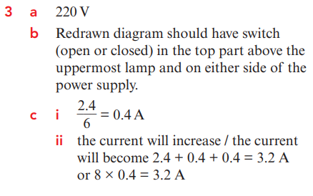
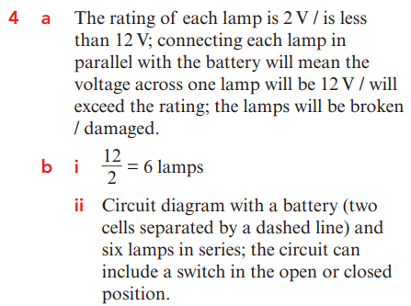

Slide 23
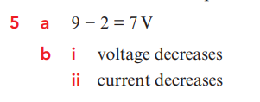

Slide 24
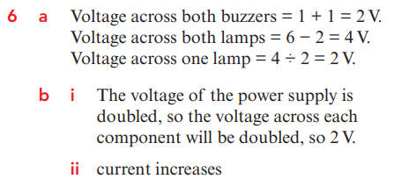

Slide 25
Reflection Time

