Slide 1
Computer system
Hardware and software

Slide 2
Watch the video

Slide 3
Hardware
Hardware refers to the external and internal devices and equipment that enable you to perform major functions such as input, output, storage, communication, processing, and more.

Slide 4
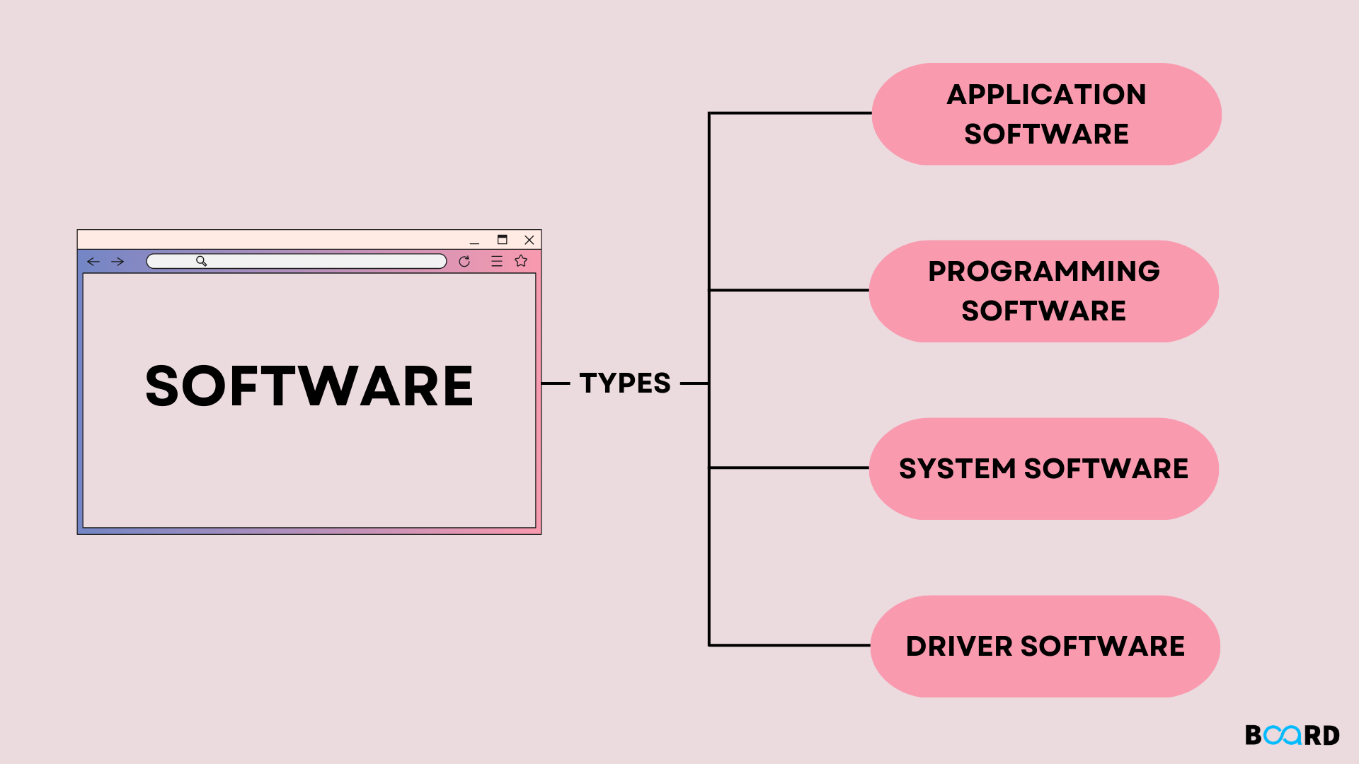
Software
Software is a collection of programs and data that tell a computer how to perform specific tasks.

