Slide 2
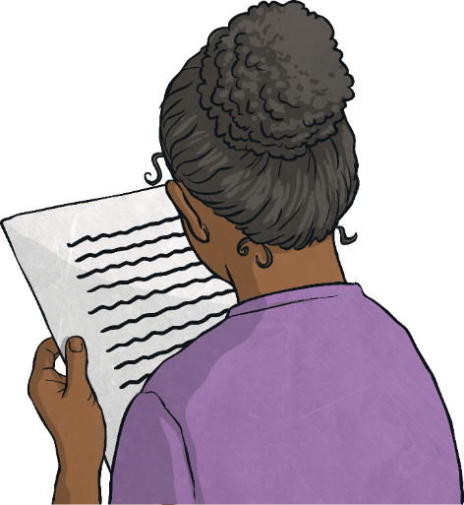
Poetry
Poetry is a form of literature and a very wide genre of writing. It is a form of imaginative writing that can be written by anybody. People choose to write poetry based on many different things. Expressing thoughts and feelings about something in a creative way is what poetry is all about.
The main aim of poetry is to involve and stimulate the thoughts of the reader. Poetry can connect with a reader on an emotional level too.
Poetry has many different forms, and can be written in many different ways. They can be short or long, fun or sad, real or imagined, structured or unstructured, rhyming or not. There is a lot of freedom when writing poetry and because of this, the writer is able to express their thoughts and feelings in very unique ways.

Slide 3
Using Syllables
A syllable is a unit of written or spoken words. Syllables are broken up sounds that are used to create words.
One syllable = monosyllabic
More than one syllable = polysyllabic
Syllables are used in poetry to create rhythm.
Look at the syllable pattern in this poem:
Cat, (1)
Fluffy, (2)
Catches mice, (3)
My faithful pet. (4)

Slide 4
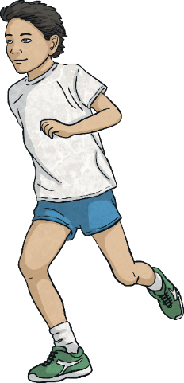
Verb
Verbs are doing words. They show actions within a sentence.
Verbs are used in poetry to create a range of effects. They are used to create more interesting sentences, and to help describe what different people and objects are doing.
Some examples of verbs:
The boy ran along the shoreline.
The women held her baby tightly.
It followed her to school one day.

Slide 5
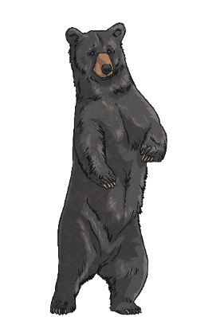
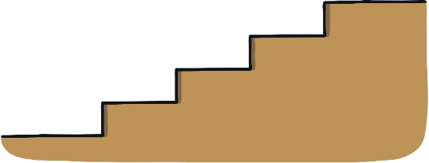
Rhyme
Rhyme occurs when two words sound the same when spoken out loud. These words usually have the same ending sounds, however they don’t need to be spelt the same.
Rhyme is used in poetry to create something interesting to read. It is used to create a pattern within a poem.
Some examples of rhyme:
Fright and night
Would hood
Should could
Hail and pale
Male and stale
Air and fare
Two and do
Day and sway
Pause and claws
Bears and stairs

Slide 6
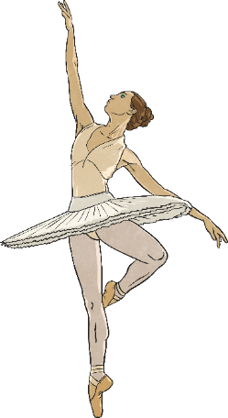
Stanza
A stanza is a group of lines gathered together by rhythmical pattern and meter. A stanza with four or more lines can be referred to as a verse. The length and pattern of a stanza decides what type of poem it is. Stanzas are made by leaving a blank space before and after it.
Two lines = Couplet
Three lines = Tercet
Four lines = Quatrain
Five lines = Cinquain
Stanzas are used in poetry to provide structure and form.
Some examples of stanzas:
I love to dance,
I love to prance.
What my heart would do,
But be sad and blue,
If I could not dance.
First Stanza
Dancing feels nice,
But it come at a price.
Dancing tutus and shoes
My gosh you can’t lose!
Second Stanza

