Slide 1
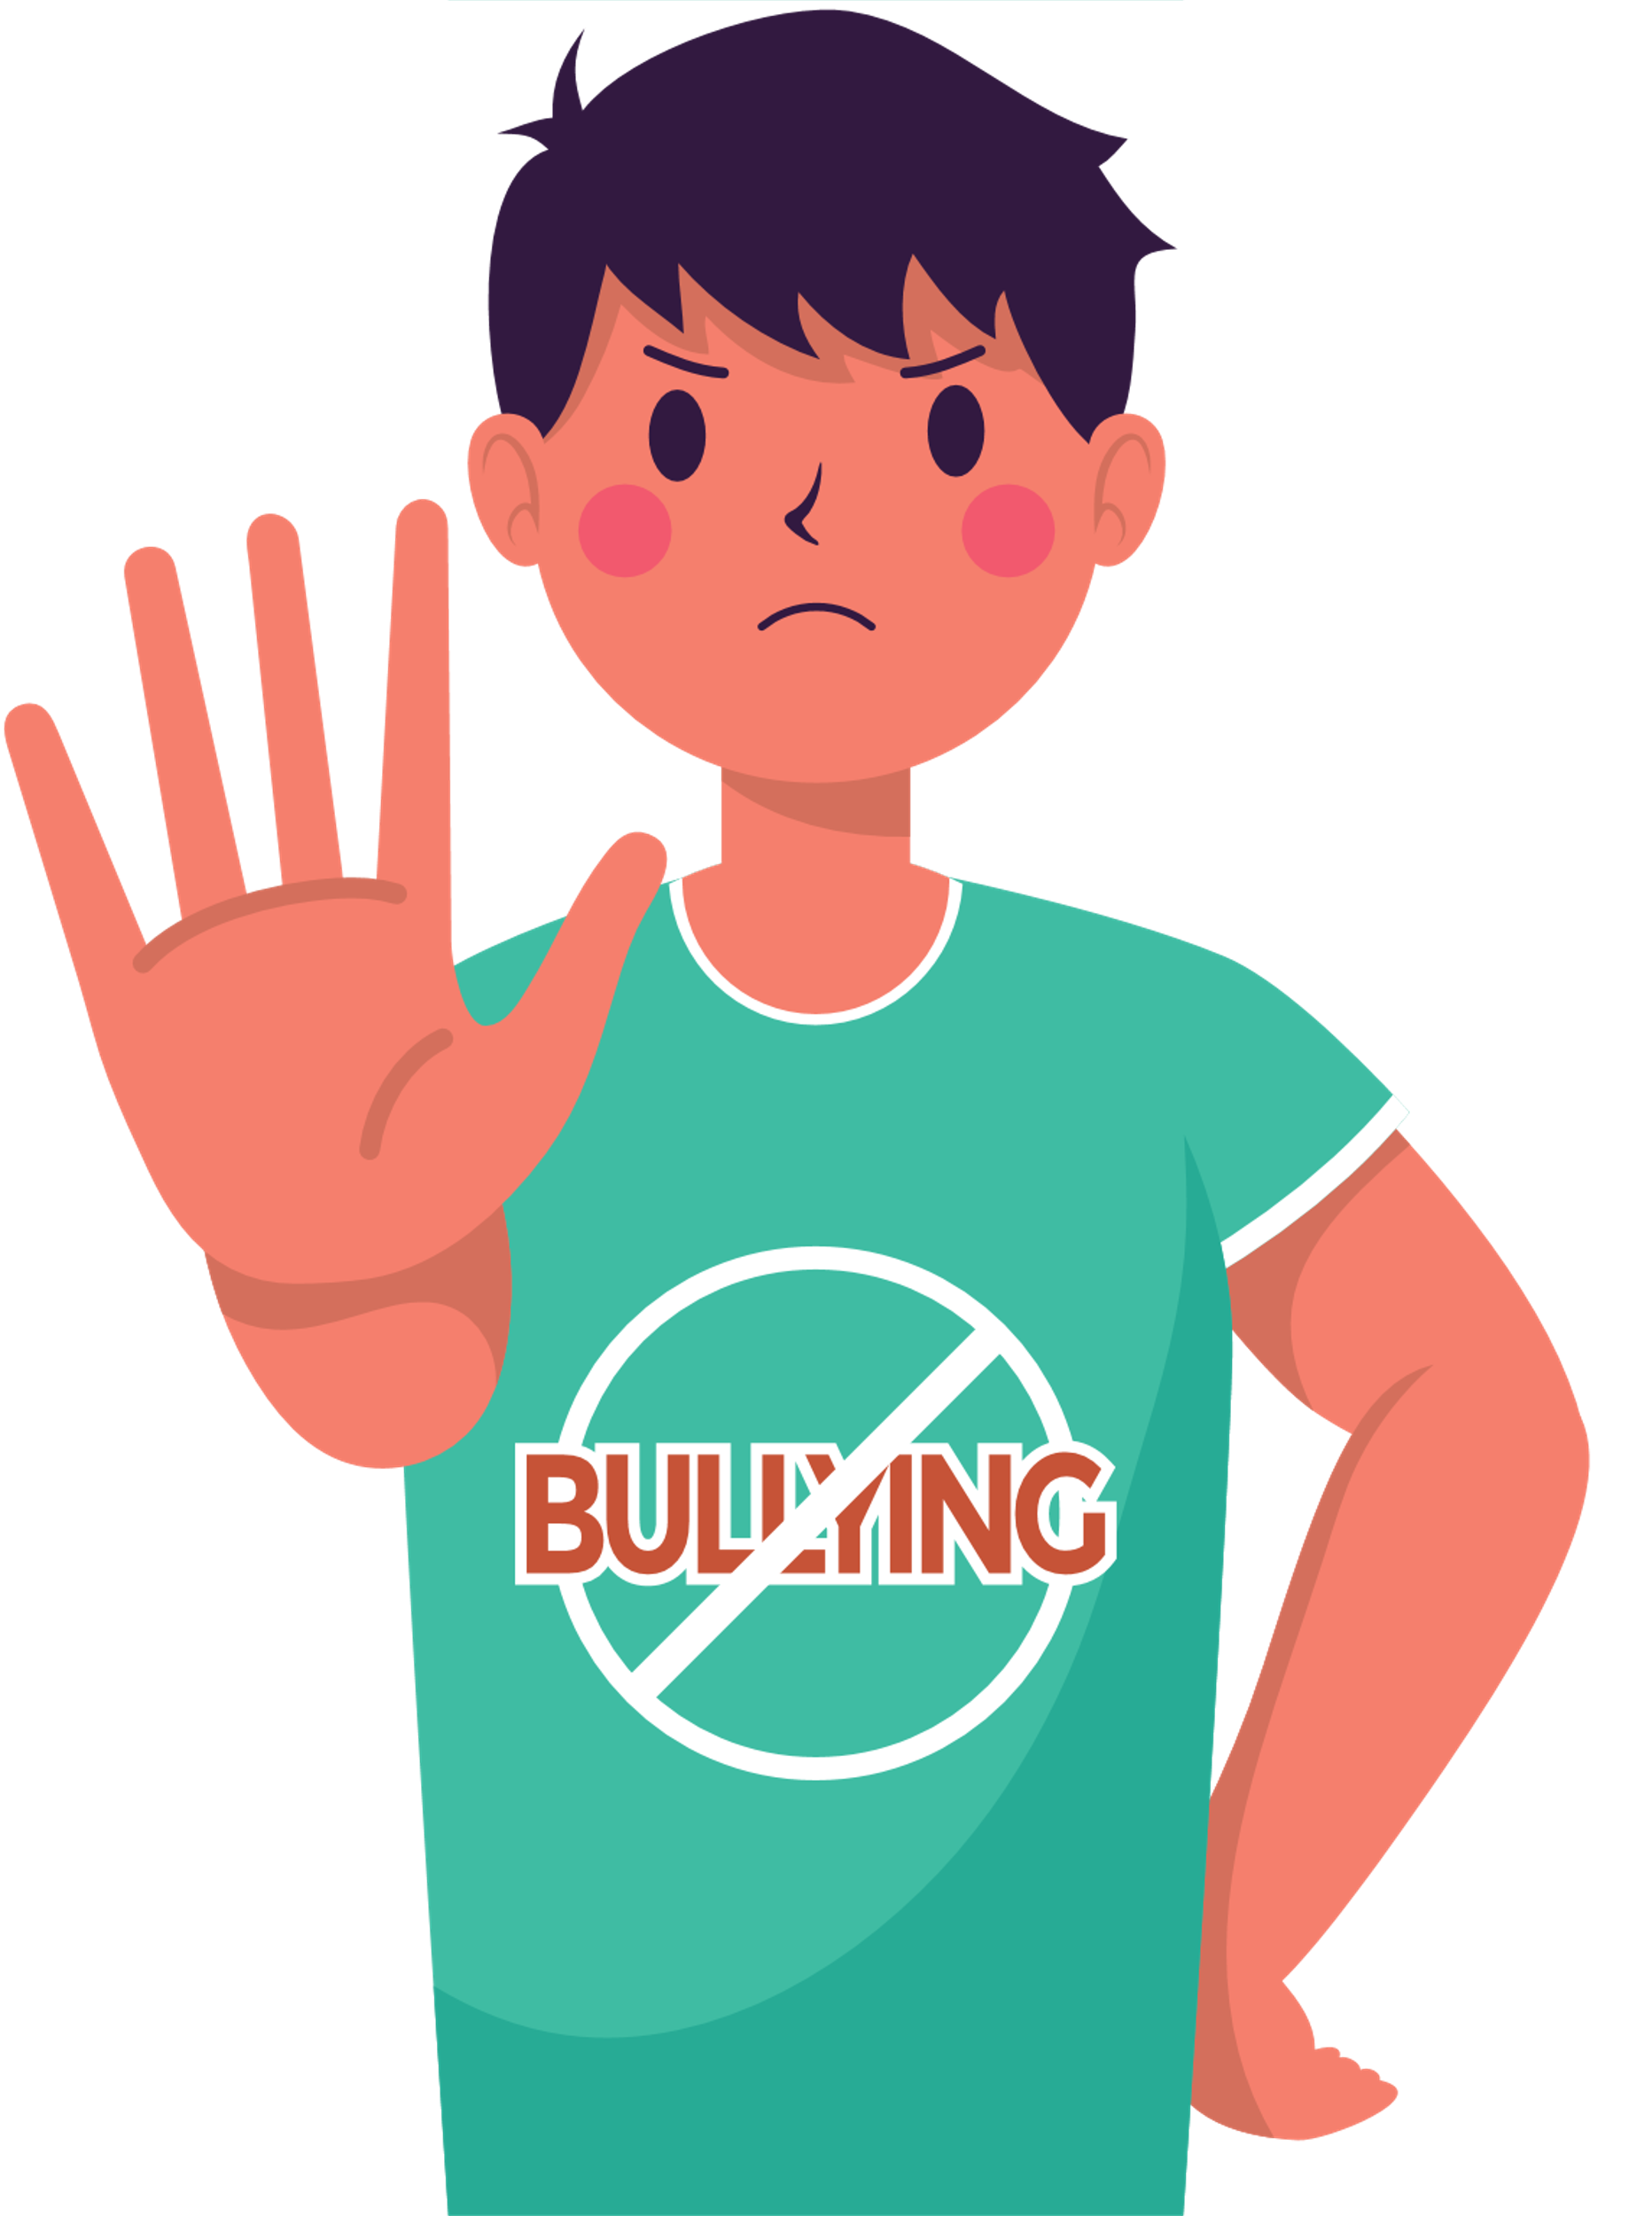
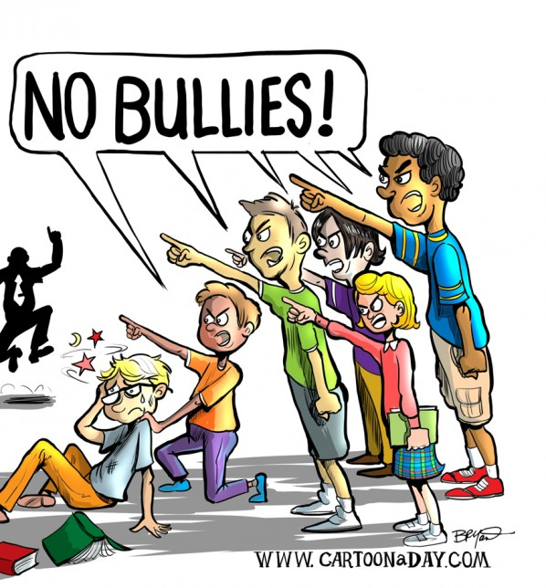
Upstanders and Allies: Taking Action Against Cyberbullying

Slide 2
Essential Question
How can you respond when cyberbullying occurs?

Slide 4
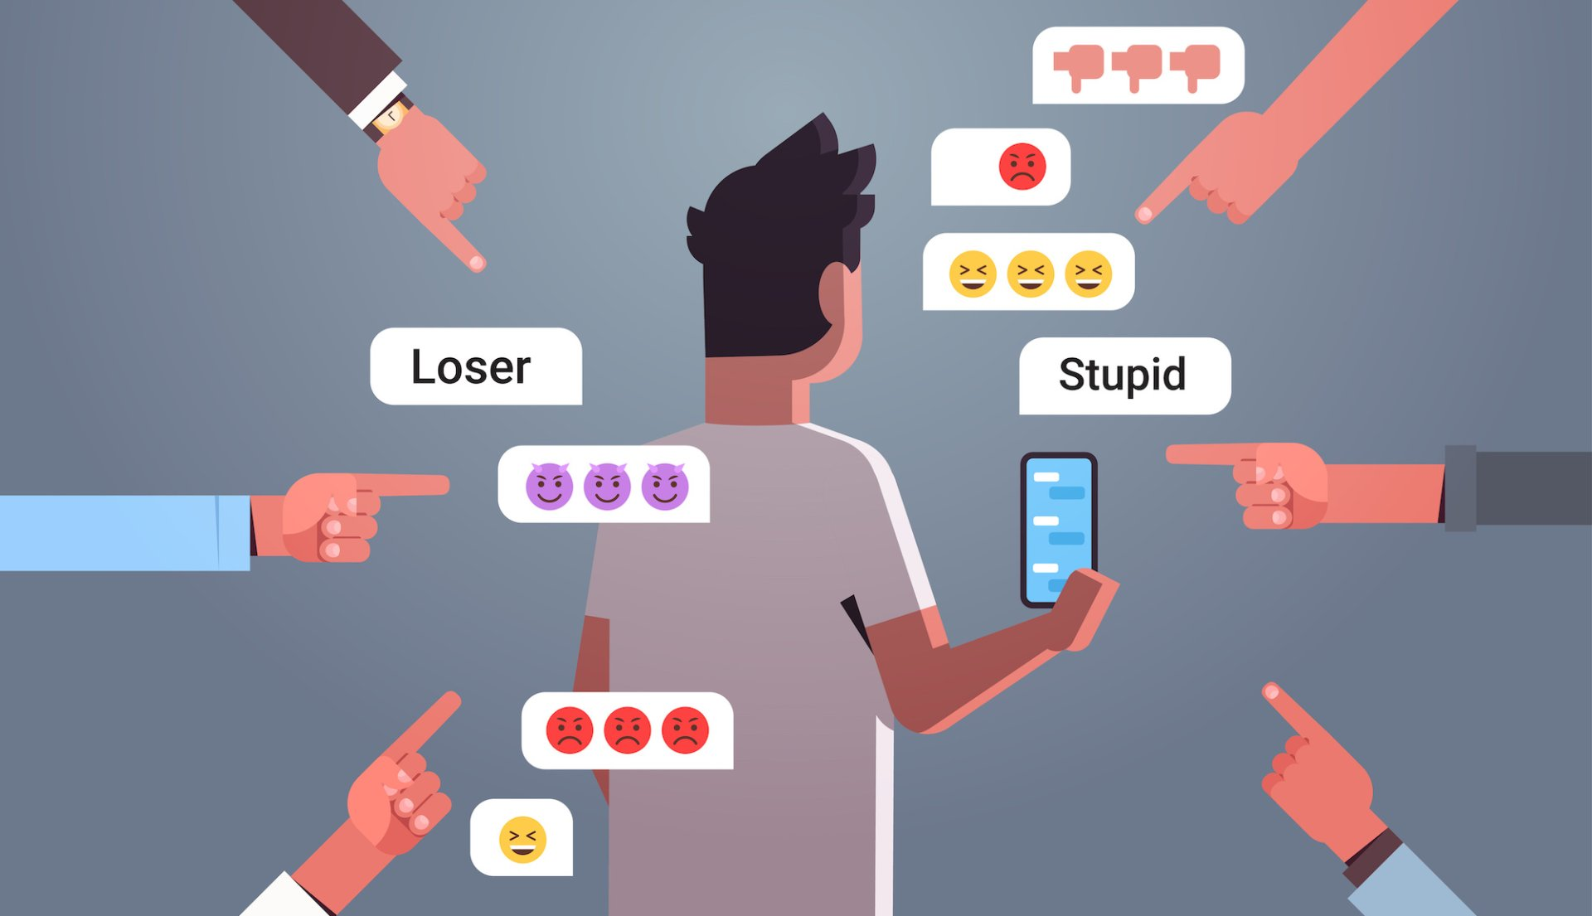
Cyberbullying
Using digital devices, sites, and apps to intimidate, harm, and upset someone

Slide 5
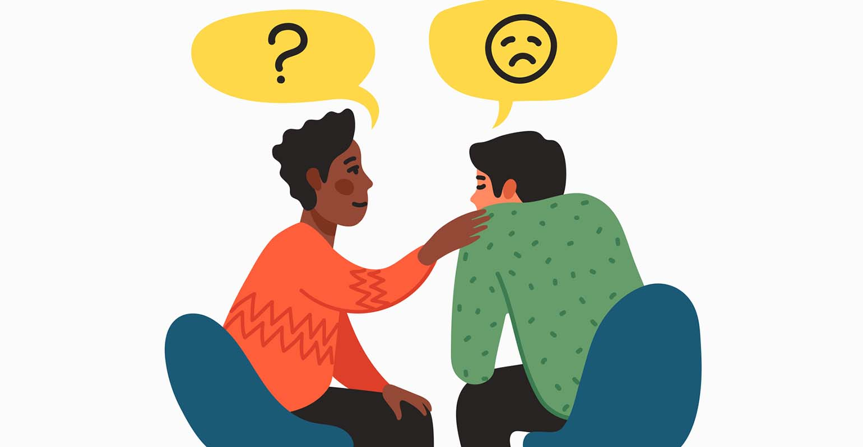
Empathy
To imagine the feelings that someone else is experiencing

Slide 6
Why do you think it might be important to try to empathize with others?

Slide 7
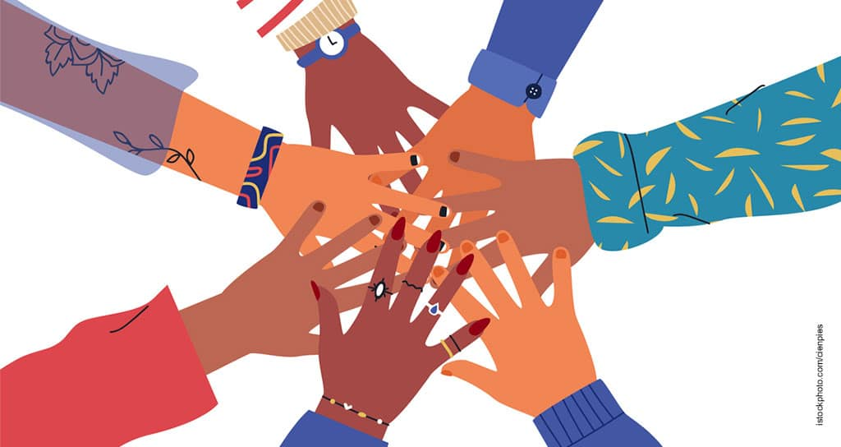
Ally
Someone who responds to a bullying situation by supporting the person being bullied
Upstander
Someone who responds to a bullying situation by confronting the bully directly or by telling a trusted adult

