Slide 1
2021 April Paper 2- p.
Reading for annotation
Year 8

Slide 2
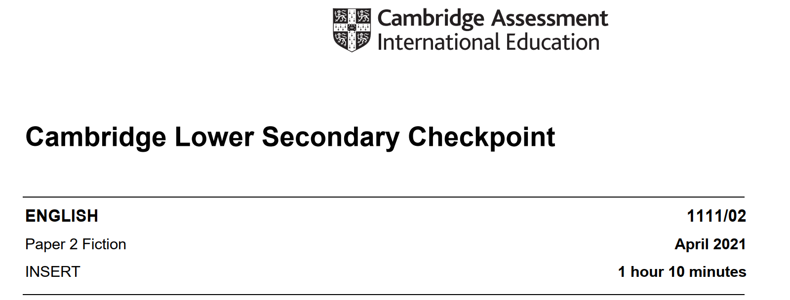

Slide 3
Objectives
By the end of the lesson, the students will be able to:
-Show awareness of the text type for a particular purpose/ audience
-Look for explicit and implicit meaning (retrieving and inferences)
-Consider word choice and connectives for purpose and organization
Discuss words within context
Answer grammar related questions

Slide 4
GAP-L your text
language
genre
audience
purpose

Slide 5
Look at the text and find the following- write them in a table in your copybook
Who is the point of view character?
What is the nationality of the main character and how do you know?
A metaphor
A simile
Connector of contrast

Slide 6
Text for Section A, an extract from ‘The House on Mango Street’ by Sandra Cisneros .
Reported speech
They always told us that one day we would move into a house, a real house that would be ours for always so we wouldn’t have to move each year. And our house would have running water and pipes that worked. And inside it would have real stairs, not hallway stairs, but stairs inside like the houses on T.V. And we’d have a basement and at least three washrooms so when we took a bath we wouldn’t have to tell everybody.
bathroom

Slide 7
Our house would be white with trees around it, a great big yard and grass growing without a fence. This was the house Papa talked about when he held a lottery ticket and this was the house Mama dreamed up in the stories she told us before we went to bed.
How, do you think the family of the narrator is like? Why?

Slide 8
What is the figure of speech used here?
But the house on Mango Street is not the way they told it at all. It’s small and red with tight steps in front and windows so small you’d think they were holding their breath. Bricks are crumbling in places, and the front door is so swollen you have to push hard to get in. There is no front yard, only four little elms the city planted by the curb. Out back is a small garage for the car we don’t own yet and a small yard that looks smaller between the two buildings on either side. There are stairs in our house, but they’re ordinary hallway stairs, and the house has only one washroom. Everybody has to share a bedroom – Mama and Papa, Carlos and Kiki, me and Nenny .
expanded
tree
road
Dash used to make a pause before to give a list

Slide 9
Flash back
Passive voice
Once when we were living on Loomis, a nun from my school passed by and saw me playing out front. The laundromat downstairs had been boarded up because it had been robbed two days before and the owner had painted on the wood YES WE’RE OPEN so as not to lose business.
‘Where do you live?’ she asked.
‘There,’ I said pointing up to the third floor.
‘You live there?’
There. I had to look to where she pointed – the third floor, the paint peeling, wooden bars Papa had nailed on the windows so we wouldn’t fall out. You live there? The way she said it made me feel like nothing. There. I lived there. I nodded.
Covered with wooden boards
Coin operating washing machine

Slide 10
I knew then I had to have a house. A real house. One I could point to. But this isn’t it. The house on Mango Street isn’t it. For the time being, Mama says. Temporary, says Papa. But I know how those things go.
Hairs
Everybody in our family has different hair. My Papa’s hair is like a broom, all up in the air. And me, my hair is lazy. It never obeys barrettes or bands. Carlos’ hair is thick and straight. He doesn’t need to comb it. Nenny’s hair is slippery – slides out of your hand. And Kiki, who is the youngest, has hair like fur.

Slide 11
But my mother’s hair, my mother’s hair, like little rosettes, like little candy circles all curly and pretty because she pinned it in pin curls all day, sweet to put your nose into when she is holding you, holding you and you feel safe, is the warm smell of bread before you bake it, is the smell when she makes room for you on her side of the bed still warm with her skin, and you sleep near her, the rain outside falling and Papa snoring. The snoring, the rain, and Mama’s hair that smells like bread.
My Name
In English my name means hope. In Spanish it means too many letters. It means sadness, it means waiting. A muddy color. It is the Mexican records my father plays on Sunday mornings when he is shaving, songs like sobbing.
What does repetition indicate ?

Slide 12
It was my great-grandmother’s name and now it is mine. She was a horse woman too, born like me in the Chinese year of the horse.
My great-grandmother. I would’ve liked to have known her, a wild horse of a woman, so wild she wouldn’t marry. Until my great-grandfather threw a sack over her head and carried her off. Just like that, as if she were a fancy chandelier. That’s the way he did it. And the story goes she never forgave him. She looked out the window her whole life, the way so many women sit their sadness on an elbow.

Slide 13
Reported question
I wonder if she made the best with what she got or was she sorry because she couldn’t be all the things she wanted to be. Esperanza. I have inherited her name, but I don’t want to inherit her place by the window.
I would like a new name, a name more like the real me, the one nobody sees. Esperanza as Lisandra or Maritza or Zeze the X. Yes. Something like Zeze the X will do.

Slide 14
Exit TICKET

Slide 15
Homework
Answer the questions on the text for tomorrow

