Slide 1
What is a 2D shape?
A 2D shape is a flat shape which only has sides or corners.

Slide 3
Properties of 2D Shapes
0 Corners
6 Sides and 6 Corners
Rectangle
Circle
Hexagon
4 Sides and 4 Corners
1 side
Pentagon
Square
Triangle
3
Sides and 3 Corners
5
Sides and 5 Corners

Slide 4
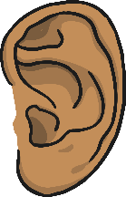
Circle
Circles only have one side.
Circles have no corners.
Click for
Audio

Slide 5
Square
Squares have 4 straight sides and 4 corners.
All the sides are the same length.
Click for
Audio

Slide 6
Rectangle
Rectangles have 4 sides and 4 corners.
They have 2 long sides and 2 short sides.
Click for
Audio

Slide 7
Triangle
Triangles have 3 sides and 3 corners
Click for
Audio

Slide 8
Oval
Ovals only have one side and no corners.
Click for
Audio

Slide 9
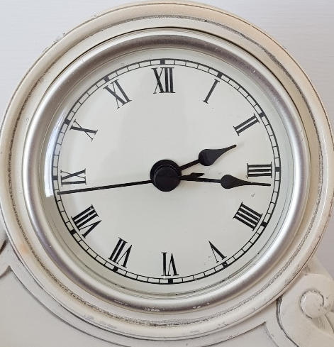
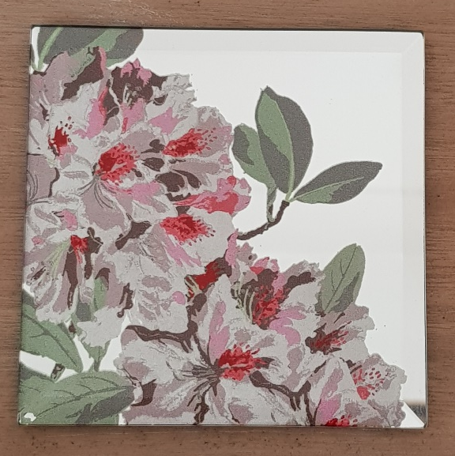
What 2D shapes can you see?

