Slide 1
3.3 Conservation of energy

Slide 2
Learning Objectives
Learn that energy cannot be created or destroyed
Understand that when energy is conserved, there is no increase or decrease in energy
Understand that thermal energy is dissipated from hotter places to colder places.

Slide 3
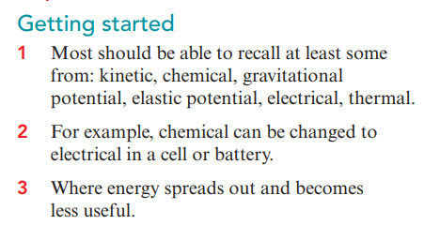
Pre-Assessment

Slide 4
Law of Conservation of energy

Slide 6
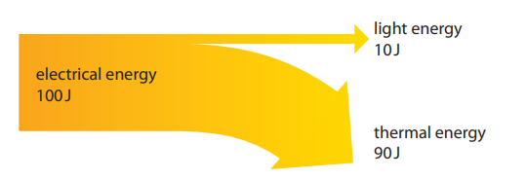
Look at the energy diagram for an electric lamp Write down your observation
In physics, saying that energy is conserved means something different from saying less energy is being used.
When we say that energy is conserved, we mean that the total quantity of energy stays the same.
This happens when energy is stored, changed, transferred or even dissipated.

Slide 7
The energy diagram shows that every time 100J of electrical energy is supplied to the lamp, 10 J of this is changed to light energy and 90 J is changed to thermal energy.
The light energy is useful and the thermal energy is wasted.
The electrical energy is called the energy input and the light and thermal energy together are called the energy output.
The total energy input of 100 J is the same as the total energy output of 10 J + 90 J = 100 J.
This shows how energy is conserved in an electric lamp.

Slide 8
The energy diagram for the engine in a car.
In the energy diagram for a car engine, the energy input and outputs are shown as percentages.
Notice that the energy input is 100% and the total energy output adds up to 100%. Once again, energy is conserved.

Slide 9
In these examples, the electric lamp and the car engine are types of system.
In physics, a system is something that has been chosen to study, especially in terms of energy changes.
The total energy output can never be greater than the total energy input in any type of system.
This is because energy cannot be created.
Created means to make something, or to bring something into existence.

Slide 10
Wasted energy, such as thermal energy, is dissipated.
Dissipated means this energy spreads out into the surroundings and becomes less useful. Although this energy is dissipated, it is not destroyed.
Destroyed is the opposite of created.
Destroyed means to damage something or to end the existence of something.
The law of conservation of energy states that energy cannot be created or destroyed, only changed from one form to another.

Slide 11
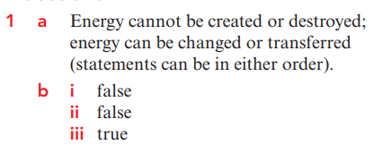

Slide 13
