Slide 1
VOCABULARY WORDS
Term 2/week 3

Slide 2
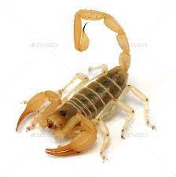
venomous
Meaning:
"it is the most venomous snake in the world"

Slide 3
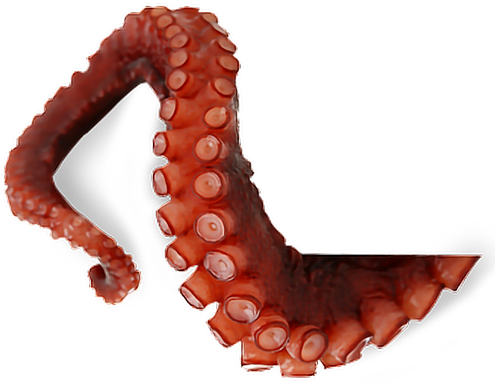
tentacles
Meaning: any long flexible structures that stick out usually around the head or mouth of an animal
Sentence:the octopus wraps its tentacles around its prey

Slide 4
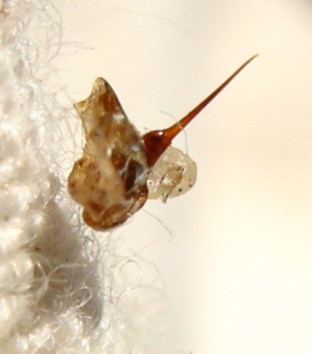
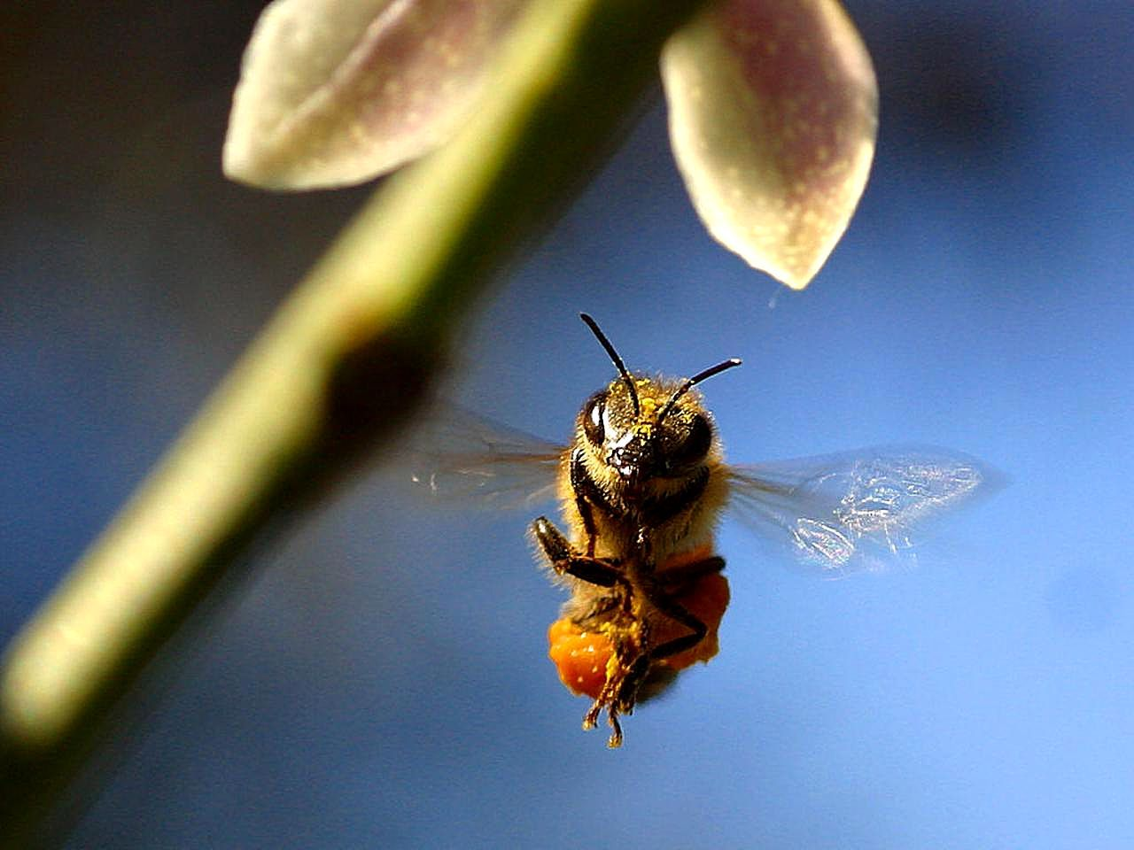
sting
Meaning: to feel a strong burning pain
Sentence: at the end of the bee’s body it has a sting
This is the bee’s sting

Slide 5
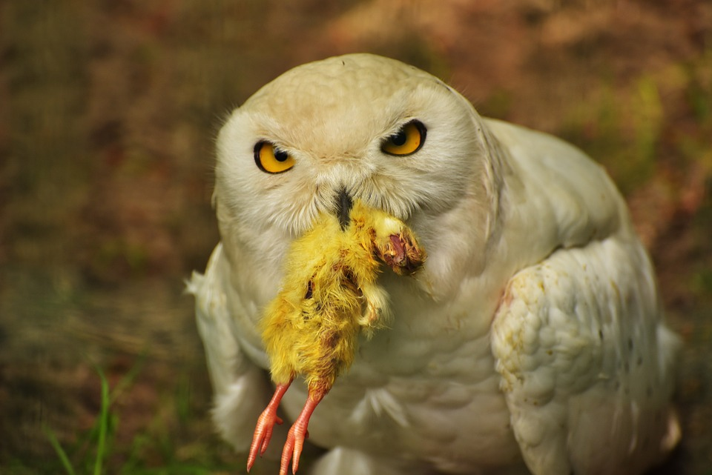
prey
Meaning: an animal hunted or killed by another animal for food.
Sentence: there’s an owl hunting for prey
In this photo the baby chick is the prey

Slide 6
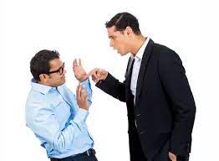
threat
Sentence:
“Their way of life is under threat”

Slide 7
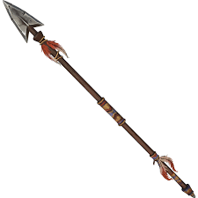
spear
Sentence:
The spear hit the lion’s
Heart.

Slide 8
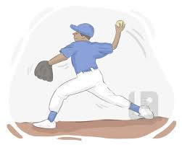
hurled
Sentence:
The man hurled the spear towards the
Fierce shark.

Slide 9
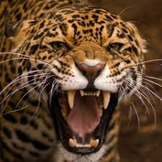
fierce
Meaning:
"fierce storms lashed the country"

Slide 10
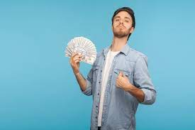
Boastful
Meaning:
"she tends to be boastful"

