Slide 1
VOCABULARY WORDS
Term 2
Week 10

Slide 2
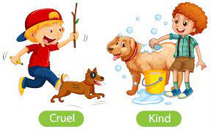
cruel
Sentence:
harsh

Slide 3
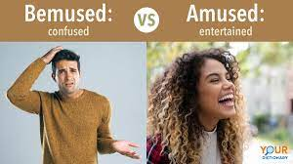
amused
Sentence:
entertained

Slide 4
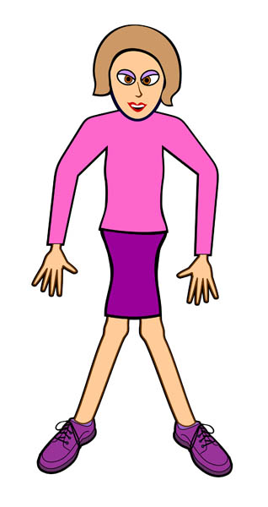
awkward
Sentence:
weird

Slide 5
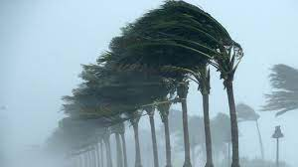
gusty
Sentence:
windy

Slide 6
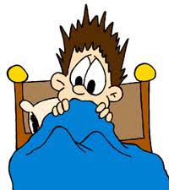
horrific
Sentence:
terrified

Slide 7
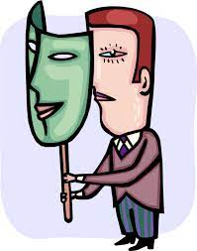
deceitful
Sentence:
untruthful

