Slide 1
English

Slide 2
Lessons Objectives
By the end of the lesson, learners will be able to :
Understand that writing instruction is a type of non-fiction texts.
understand what conjunctions mean
01
Understand the main features of writing instructions.
02
03
Write instructions using the main features.
04

Slide 4
Instructions
Instructions are written for someone who needs to know how to do something.

Slide 5
What are instructions for?
Some examples…

Slide 6
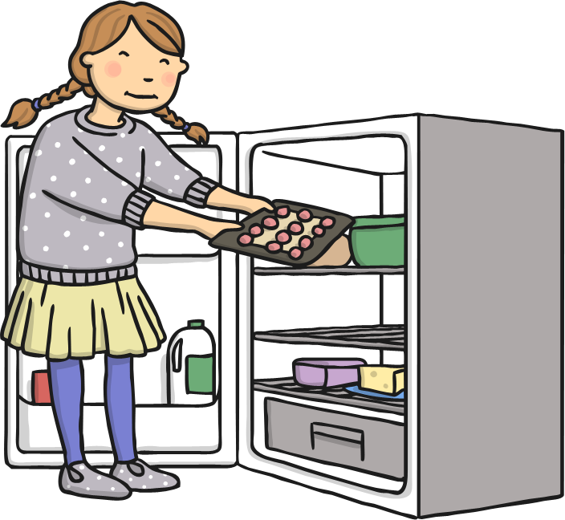
Recipes

Slide 7
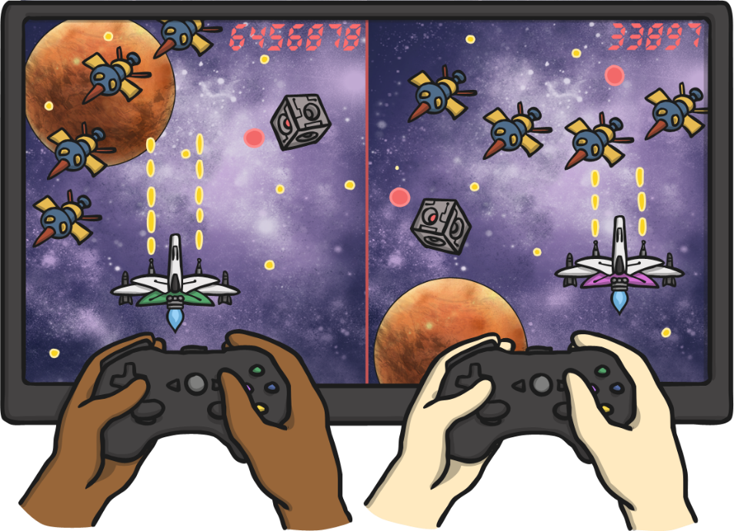
‘How to play a game’

Slide 8
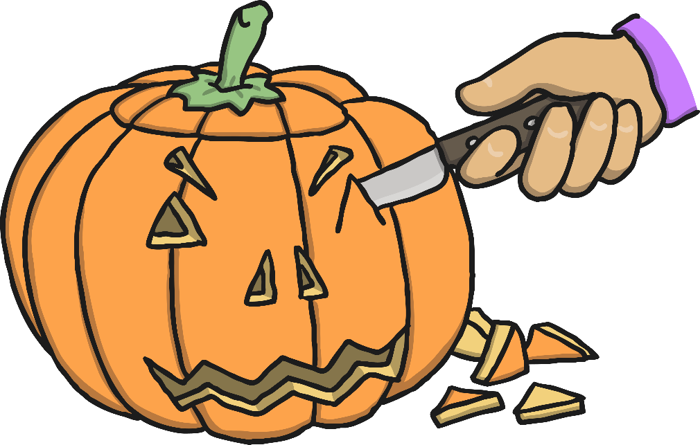
‘How to make a…’

Slide 9
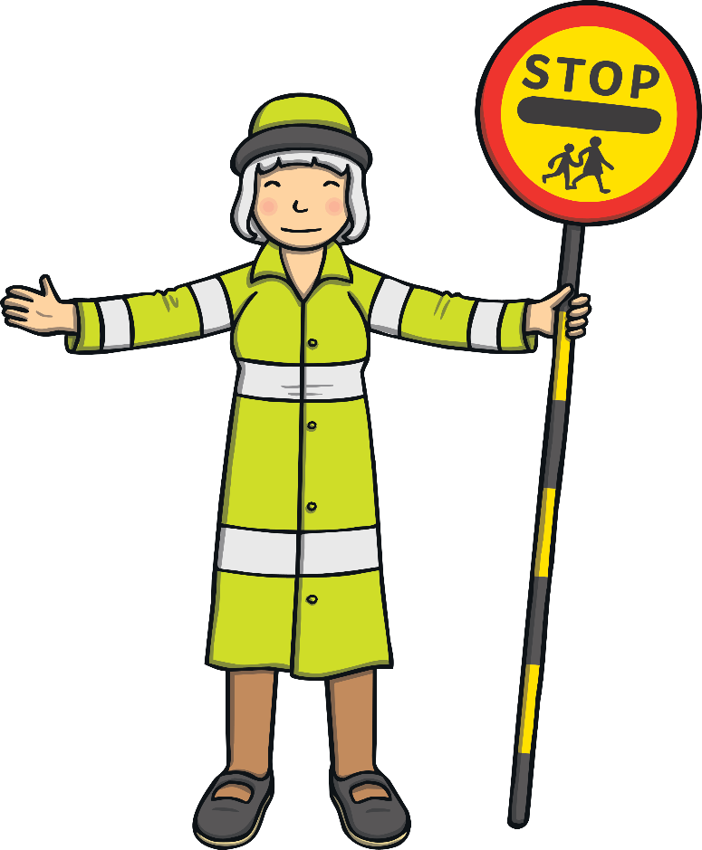
Safety Procedure Posters

Slide 10
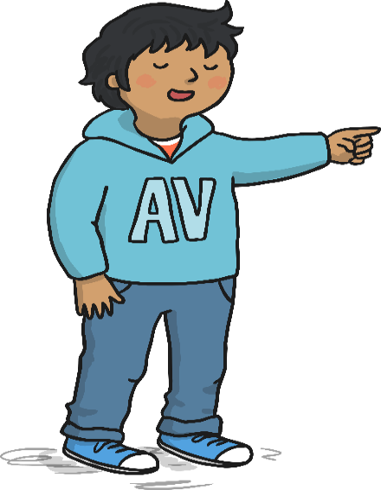
How to Write Instructions
1. Write in the present tense.
2. Use imperative (bossy) verbs like, eat, sleep, study, put.
3. Use time conjunctions like first, next, then, after that, at last or you can use ordinal numbers like first, second, third, fourth, fifth…………………
4. Use clear descriptions and write your instructions in sentences using time connectives not a paragraph..

Slide 11
Can you spot out the bossy verbs?
Eat will eat went go
Jump is walking put walked do was writing finish pour was drinking
Play feed played
Make made is making
Sleep write spread

Slide 12
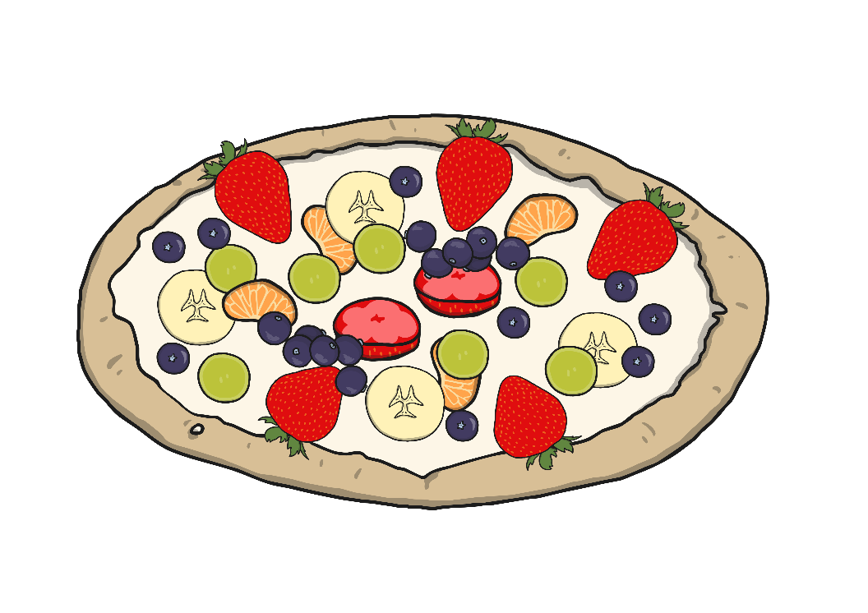
How To Make Fruit Pizzas
You will need:
Digestive biscuits
Natural yoghurt
3 – 4 different types of fruit e.g. Apple, banana, grapes, orange
Plate
Spreading knife
Sharp knife
A grown up!
What to do:
First, place your biscuits on the plate.
Then, spread the yogurt onto the biscuit.
Carefully cut up the fruit into small pieces. (Ask a grown up to help you with the sharp knife)
Finally, put the fruit on top of the yogurt.
Enjoy!
Top Tip:
Keep the fruit pizzas in the fridge once made.
Notes:
Image request has been made to change this pavlova image to have a biscuit base.

Slide 13
Lessons Objectives
Objectives check:
Understand that writing instruction is a type of non-fiction texts.
01
Understand the main features of writing instructions.
02
03
Write instructions using the main features.
04

